Slide 1


Utah Computer Adaptive Assessment System
Judy W. Park, Ed.D., Associate Superintendent, Utah State Office of Education

Slide 2
Questions
?
?
?
?
?
?
?
?
?
?
?
?
?
?

Slide 3

Top 10 Questions
Additional FAQs
available on the
USOE Website
http://usoewebstage/assessment/Adaptive-Assessment-System.aspx

Slide 4
Top 10 Questions
What was the selection process?
What are the state purchasing requirements?
Who was awarded the contract?
What is the new assessment system?
Will low and high achieving students be accurately assessed?
Will the assessment include national norms?
What is the implementation timeline?
What is the transition plan?
What assessment reports will be available?
What are the terms of the AIR contract?

Slide 5
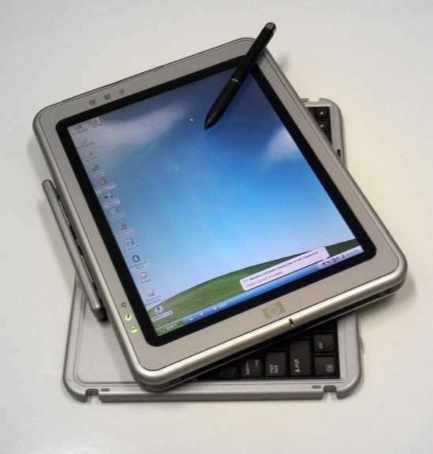
FAQ #1
What was the process to select a state computer adaptive assessment system?

Slide 6
RFP Process
Board Leadership selected the RFP Writing committee members
  Three Board members on the committee
Stakeholder survey for input into the RFP
All Board members invited to review the RFP and provide input
Board Leadership selected the RFP Selection committee members
  Two Board members on the committee

Slide 7
Superintendent Charge to RFP Writing Committee
“Write an RFP that engages the broadest spectrum possible in the marketplace and encourages innovative solutions that will result in an assessment system that meets all the needs of Utah students and educators”

Slide 8
State Purchasing Charge to the RFP Selection Committee
“Review all proposals and make a recommendation for the proposal that best meets the requirements in the RFP”

Slide 9

FAQ #2
What are the
State Purchasing requirements and processes?

Slide 10
State Purchasing Requirements
RFP written by experts in the subject matter
Internal Review by Procurement officer
State Purchasing Review
RFP Released to the public
Proposals Evaluated and Scored
  State Purchasing determines cost points (30%)
State Purchasing awards contract

Slide 11
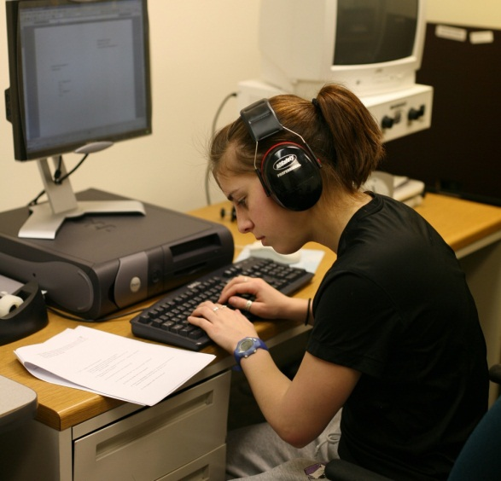
FAQ #3
Who was awarded the contract to assist Utah in developing and administering the computer adaptive assessment system?

Slide 12
American Institute for Research - AIR
Only State Computer Adaptive Systems
  Oregon, Delaware, Hawaii, Minnesota
60 years experience
  NAEP, TIMMS, PISA, other countries
  8 million tests each year (adaptive and paper/pencil)
One of 21 vendors for SBAC
Only vendor with current iPad capability

Slide 13

FAQ #4
What is the new computer adaptive assessment system?

Slide 14
Utah Computer Adaptive Assessment System
Summative – spring of each year
Interim – fall and midyear
Formative – teacher flexibility
Language Arts, Math, Science
Grades 3 – 12
Fall to spring and spring to spring growth

Slide 15
Utah Computer Adaptive Assessment System
Features
  Aligned to Utah Core Standards
  Unique solution to Utah – Utah has complete control of assessment items, system and reports
  More than multiple choice test items
  Broadest range of technology platforms (oldest to iPads)
  Web-based system requires minimal local support
  Individualized accommodations for each student

Slide 16
Utah Computer Adaptive Assessment System
Summative – Required for Accountability
  Spring of each year
  Adaptive with immediate results
  More than multiple choice
  Spring to Spring growth

Slide 17
Utah Computer Adaptive Assessment System
Interim - Optional
  Fall and midyear
  Adaptive with immediate results
  Predictive of summative
  More than multiple choice
  Allows fall to spring growth

Slide 18
Utah Computer Adaptive Assessment System
Formative - Optional
  Teacher flexibility
  Questions pre-developed or teacher developed
  Integrated reporting system with summative/interim
  Includes open source library and imported UTIPS items
  Connected to resource libraries

Slide 19

FAQ #5
Will low and high achieving students be accurately assessed?

Slide 20
Adaptive for Everyone
Full range of students from low performing to high performing
Utilizes grade level content
Science Example:
  4th weather, 5th solar system, 6th rocks
  A 5th grade student will not receive questions about the weather – but full ability range on solar system

Slide 21
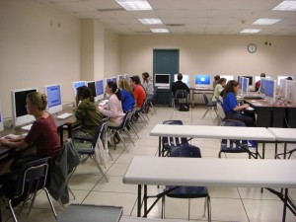
FAQ #6
Will the assessment include national norms?

Slide 22
National Norms
National norms for the common core do not currently exist
Currently, there are no tests being administered in multiple states that are aligned to the common core
Over time, this will be possible

Slide 23

FAQ #7
What is the implementation timeline?

Slide 24
Timeline
January 2013 - Board approves contract
Spring 2013 – current summative assessments (CRT & NWEA) administered last time
Fall 2013 – Formative tests
Spring 2014 – Summative Field Test
  Does not require double testing
  Results delayed until July 1 (1st year only)
Fall 2014 – Interim Tests

Slide 25

FAQ #8
What is the transition plan?

Slide 26
Transition Plan
Communication
  Monthly webinars
  Monthly updates to State Board, USSA, LEA Directors
Item & Test Development
  Items from multiple sources
  Involve Utah educators in new development
Technology
  Technology Standards
  Self Assessment Rubric

Slide 27

FAQ #9
What assessment reports will be available?

Slide 28
Reporting
Immediate results
Robust electronic reporting
  Students & Parents
  Teachers
  Public
Diagnostic information for all students
  Low achievement to high achievement

Slide 29

FAQ #10
What are the terms of the
AIR contract?

Slide 30
What are the terms of the contract
5 year contract
$39 M over 5 years
  Development of items
  Interim and Summative tests
  Formative system
  Reporting system
  All work for federal approval
  Training
  Parent review committee

